Slide 1
Research Methods I
Introduction to the Course

Slide 2
Agenda
Meet the instructor
Course details
Class policies
Canvas tour
Next time on PSY 270…

Slide 3
What makes a good introduction?

Slide 4
Meet the Professor
Valid
Representative
Relevant
Sufficient
Unbiased

Slide 5
Contacting Me
Office Location
  Copeland Hall 320E
Office Hours
  MW 2:30pm – 4:30pm
  T 2:30pm – 3:30pm
  By appointment
Email: scheulerb2@unk.edu
  Please use guidelines in syllabus
  DO NOT use "messaging" on Canvas – there’s a decent chance I will never see it
Subject: PSY 270 [SUMMARY OF EMAIL HERE]
Hello Dr. Scheuler,
Write your question(s) here, in full sentences and full words (e.g., no abbreviations such as “IDK”). If your question refers to a certain chapter, exam, or assignment, be sure to specify which item you are referring to in your email (e.g., instead of saying “I need help understanding the role of reliability in this week’s research activity,” you could say “I need help understanding the role of reliability in the Chapter 11 research activity”). If you would like to discuss the question in person, please provide times of availability, such as:
Tuesday 4-5pm, Wednesday 8-9am, 11am-12pm, Friday, after 3pm
Thank you,
Your Full Name

Slide 6
Course Details
What this semester entails…

Slide 7
Context: The Research Class Pathway
Part 1:
  PSY 250: Behavioral Statistics
  PSY 270: Research Methods I
Part 2:
  PSY 271: Research Methods II
{take other classes}
Part 3*:
  PSY 495: Psychological Inquiry

Slide 8
Roll Call
Stats Background:
-Have you already taken stats?
-Are you taking it currently?
-Will you be taking it in the future?

Slide 9

Require Material
Morling, B. (2025). Research methods in psychology, 5th Edition. W. W. Norton. ISBN: 978-1-324-08580-5 (Ebook with InQuizitive Access).
One of the assignments is embedded in the chapters, so make sure you have access to the Ebook, even if you get a printed version (it should come with a code at the front of the book)

Slide 10
The Typical Approach to a Chapter
Read the textbook chapter
  Ebook assignments built into the chapter to assess knowledge as you read
Lecture on chapter’s content
  2-3 class days discussing the content, where I break down the content (similar, but complementary to the textbook)
Apply content in a research activity
  Usually completed in person, sometimes online
Practice quizzing over the content
  Due by the time we complete the chapter in class
  Can keep working until you get a perfect score
  A good way of determining if you’re ready to take an exam over that content

Slide 11
Class Assignments
Class Participation
  Need at least 40 class days
  Keep track outside of Canvas
Ebook Assignments
  14 chapters; 1 assignment/ chapter
  Lowest 2 dropped
InQuizitive Assignments
  14 chapters plus one introductory assignment
  Lowest 2 dropped
Research Activities
  One per chapter
  Lowest grade dropped
Exams
  Three unit exams, one comprehensive final exam
  Completed in-class, with a blend of scantron and short answer questions
Activity | Possible Points
Class Participation | 40 points
Norton Ebook Assignments | 120 points
InQuizitive Assignments | 130 points
Research Activities | 260 points
Exams | 450 points
 | 1000 points

Slide 12
Timeline
Unit 1:
  Chapters 1–4
  Exam 1: September 23rd
Unit 2:
  Chapters 5–7
  Exam 2: October 21st
Unit 3:
  Chapters 8–11
  Exam 3: November 20th
Unit 4:
  Chapters 12–14
  Final Exam: December 14th (10:30am)
Note: The syllabus has what topic is covered each day. Additionally, Canvas will tell you what we are working on each week, with links and deadlines

Slide 13
Class Policies

Slide 14
Class Attendance
When in class, please respect your instructor and fellow classmates.
What you learn in this class will be very important for your entire research class pathway. The more you dial in to this class, the easier those classes will be.
Please don’t come to class if you are sick, even if you don’t have a doctor’s note.
  You only need 40 days of attendance (and our class meets more than 40 times throughout the semester)

Slide 15
PowerPoints Provided
All PowerPoints are provided as links on Canvas
  Hosted on GitHub, so students familiar with GitHub may elect to clone the repository
  If you are not familiar with GitHub but would like to start using it, I am happy to help during office hours/ an individual meeting
Goal: don’t waste time writing what’s on the screen, write down examples and discussions that will complement the notes you’re already provided with

Slide 16
Late and Missing Work
Textbook assignments (Ebook and InQuizitive) can be completed late, but there is a 20% penalty for each day it is late
If you know you will be absent for a university-approved event, let me know at least one week before, so we have time to create an alternative BEFORE you are gone
  For example, if you will miss an exam, the exam is supposed to be taken before the absence

Slide 17
AI Use
AI is a tool, but not every tool is a good fit for every job
Would you use a tractor to weed around your flowers? Or would trying to do so destroy the point?
What do YOU think is the point of this class?

Slide 18
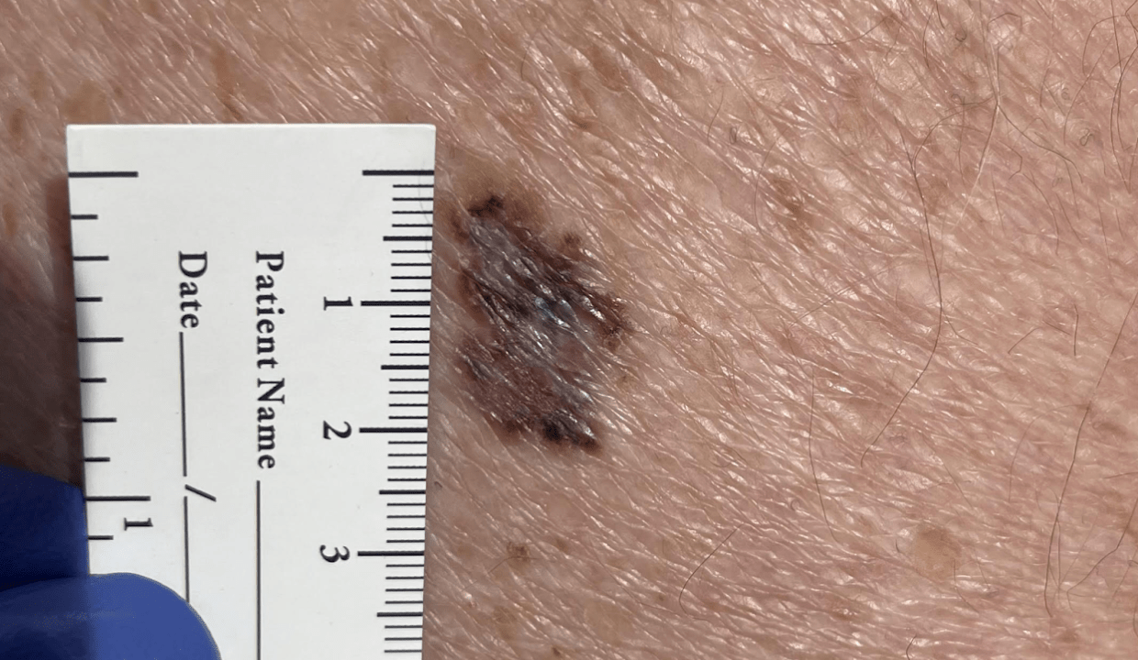
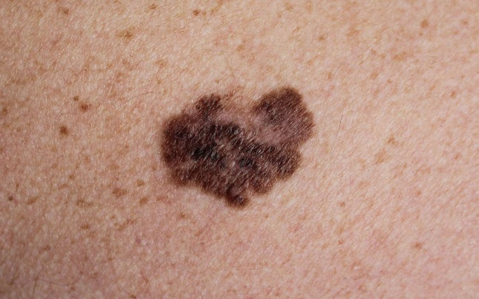
Reasons AI is Not a Good Tool for This Class
Cognitive offloading vs. cognitive debt
Pattern recognition does not equal intelligence
Cheating is heavily penalized for the research classes
Degrees can become meaningless with too much AI

Slide 19
Guide to Canvas
Don’t forget about the Canvas transition. The link you want to use now is: https://canvas.nebraska.edu/
  (We are now consistent across the entire system UN schools)
Feel free to follow along if you have your own computer/ tablet with you

Slide 20
Next Time on PSY 270…
Before Next Class(es):
Purchase Textbook
Complete “How to Use InQuizitive” assignment
  Due 8/28 at 11:59 pm
Read Chapter 1 and complete Ebook: Chapter 1 assignment
  Due 8/28 at 11:59 pm
Complete InQuizitive: Chapter 1
  Due 8/28 at 11:59 pm
Next Class:
Chapter 1: Psychology is a Way of Thinking

